Slide 1
Simple Banking Application Presented By Jugge Chandrika Batch: 2021-6768 Under the Guidance of, Pooja Mehtha

Slide 2
Content:
1.INTRODUTION
2.LANGUAGE & PLATFORM
3.TYPES OF OPERATIONS
4.FUNCTIONS DESCRIPTION
5.CONCLUSION
6.CODE OUTPUT

Slide 3
1 . INTRODUCTION
In simple banking application project learner will be coding the simple bank operations like check balance ,deposit,withdraw,exit,etc.In this project learner will be learning how to take input from the user using Scanner class., basics about String how to print in java,Variables, If/Else Statements ,Methods,Loops etc.
And we have used two classes BankApp class is used to give input values for some of private members initialised in BankOps class.
BankApp class also calls the methods present in BankOps class which performs deposition and withdrawal of Amount .
BankOps class simply takes input and performs operations through methods present in it. Used if-else loop to check if the given input is matching our requirements to make further operations. Used, Scanner class is used to give some inputs like pinCode, choice to make withdraw or deposite.

Slide 4
we are explaining about operations and functions also created a reference to the class in the methods like Withdraw,Deposit,Checkbalance,Accountdetails etc.
By using this reference we can call the methods from main method. Used if-else loop to check if the given input is matching our requirements to make further operations .
Also used methods inside a Class and accessing them from main method which is present in another class.
Scanner class is also used to give some inputs like pinCode, choice to make withdraw or deposite .

Slide 5
2. LANGUAGE & PLATORM
Language: Core Java (Loops, Statements, Scanner)
Platform:
IDE:Spring Tool Suite
Operating System: windows

Slide 6
3. TYPE OF OPERATIONS
1.Withdraw : With the help of reference created in main method we are calling withdraw method from another class and by using if-else loops we are printing the respective output.
2.CheckBalance: By using reference which is created in main class we are calling checkBalance method to display the account details by using instance variables.
3.Deposite: With the help of reference created in main method we are calling Deposite method from another class and by using if-else loops we are printing the respective output.

Slide 7
4. FUNCTIONS DESCRIPTION 1.Variables:
Variables:
s.no | Variable name | Description | Data Type | Size
1. | Acc.no | Account No | String | -
2. | Name | Applicant Name | String | -
3. | Bal | Applicant Balance | int | 4
4. | Pin no | Applicant pin .no | int | 4

Slide 8
2. Statements:
If statement = If Statement tests the condition.It executes if block when condition is true.
Else statement = Else Statement is used to checks the condition is true or false.
3 .
choicew = It is boolean Datatype
choiceD = It is boolean Datatype
amountw = It is Int Datatype
amountD = It is Int Datatype

Slide 9
5. CONCLUSION
Here , I Conclude that , when we give correct pinNo as an input while running if will further checks if conditions and executes according to the code.
Then we further checked if condition with Boolean data type to whether withdraw money or deposite money.
Also we have used the Core Java that is JAVA8 .

Slide 10
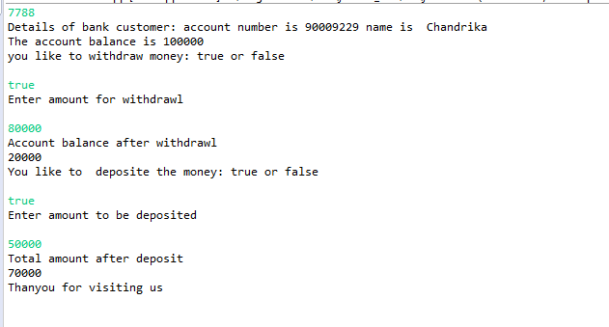
6. Code Output When pin is correct –

Slide 11
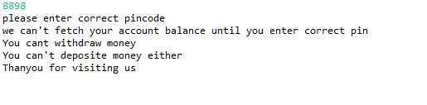
When pin is wrong –
When pin is wrong –

